Slide 1
Factor Based Radex Visualizations in R
Nils Petras
Notes:
My name is… I work on my masters thesis…
Creating an R package

Slide 2
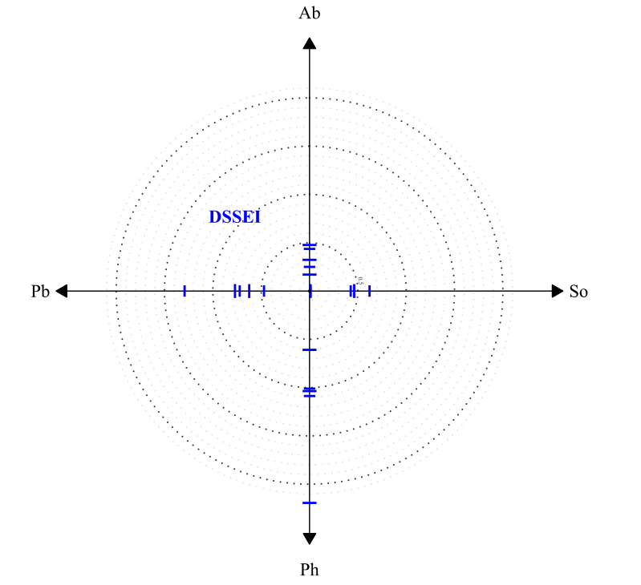
Notes:
Items can be located relative to the facets and the general factor
we can see common deviation from the general factor within a facet
DSSEI Domain Specific Self-Esteem Inventory
Ab Task-Related Abilities
Pb Public Presentation
So Social Competence
Ph Physical Appeal
Physical inhomogeneous

Slide 3
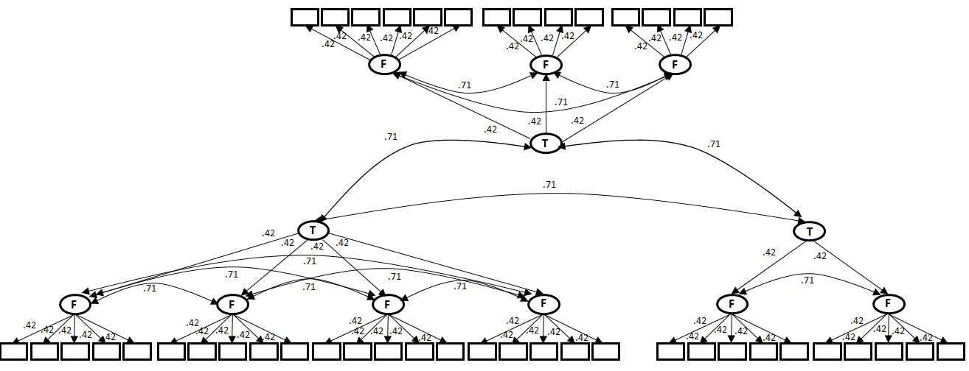
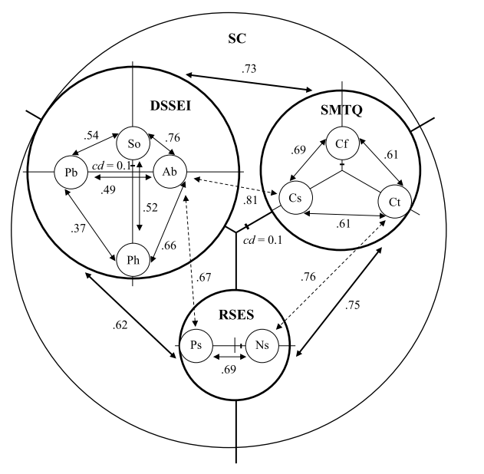
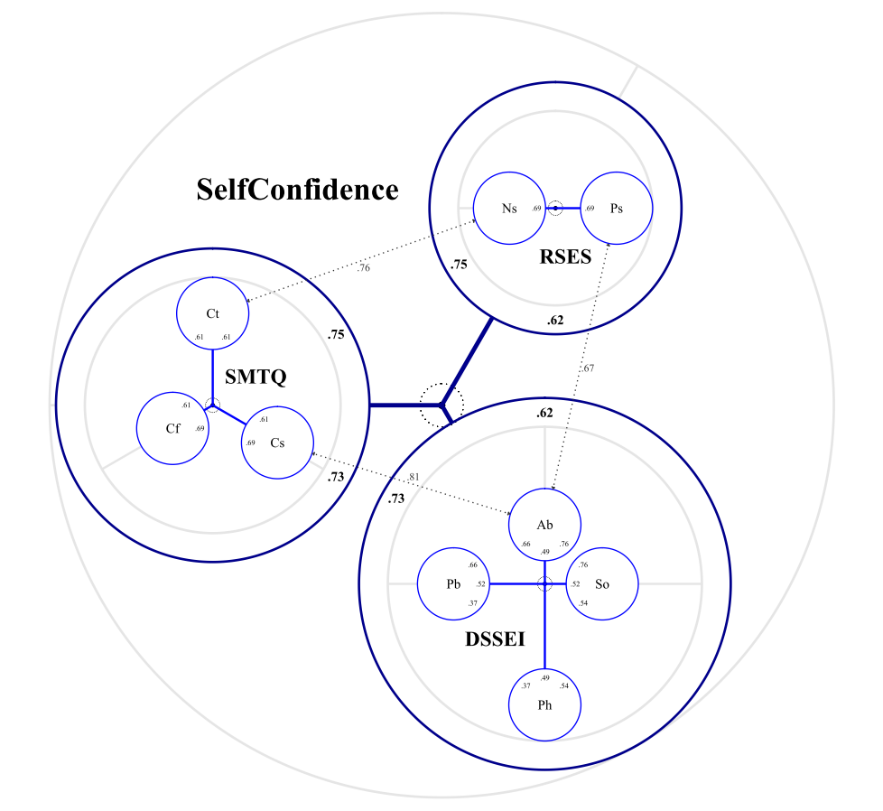

Slide 4
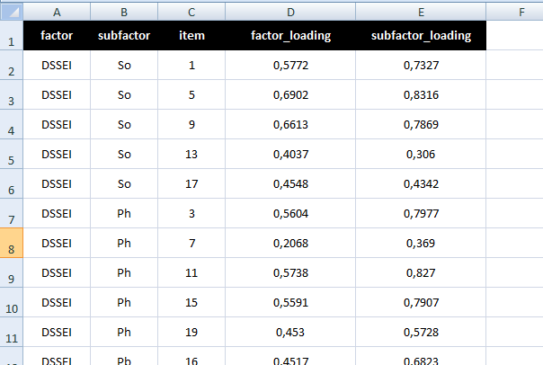
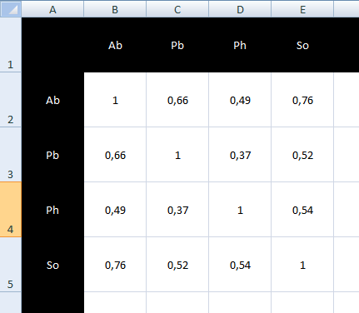
since then…

Slide 5
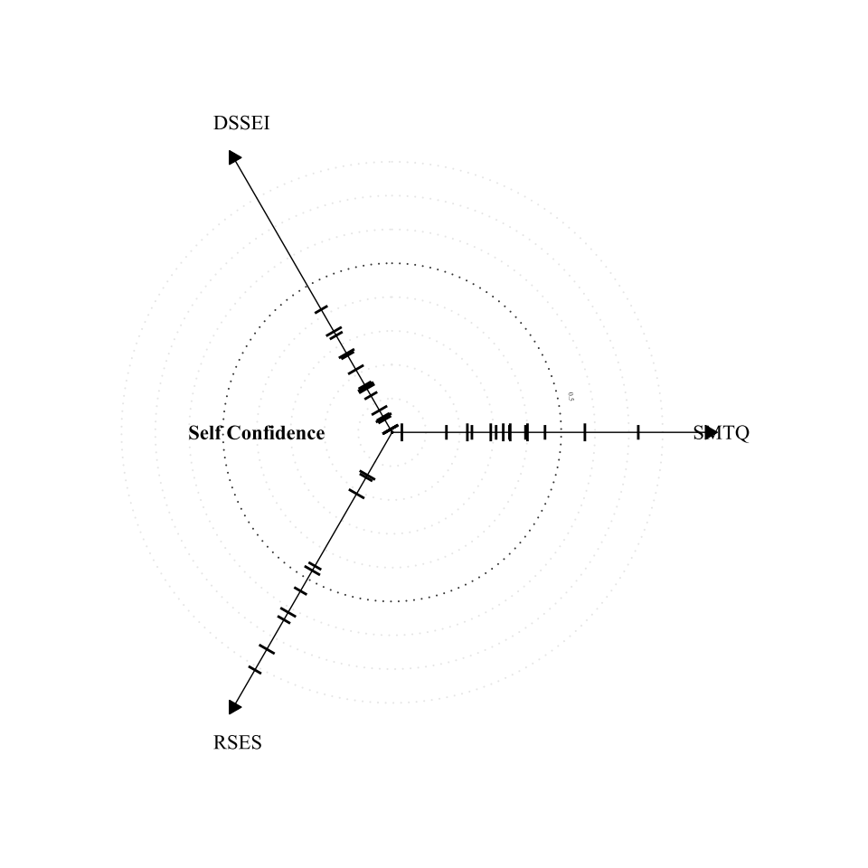
since then…

Slide 6
In the future
Documentation
Usability test
- we got the technology
Writing the thesis

Slide 7
My interests:
Anything concerning R
Your experience with usability tests
Giving and receiving feedback
Ideas/contacts for the future (PhD?)

Slide 8
0157 74002011

